Slide 1
HTML 5 Table

Slide 2
Tables in HTML
Tables are used to organize the data in rows and columns.
HTML uses tables to present content in rows and columns.
Early version of HTML [4] used tables for designing entire document.
HTML 5 introduced new elements and attributes for designing tables.

Slide 3
HTML 5 table elements are
Element | Description
<table> | It is a collection of rows and columns.
<caption> | It sets caption for table.
<thead> | It defines the table header section.
<tbody> | It defines the table body section.
<tfoot> | It defines the table footer section.

Slide 4
<th> | It defines column heading content.
<tr> | It defines the table row.
<td> | It defines the table cell content.
<colgroup> | It groups a set of columns to define effects.

Slide 5
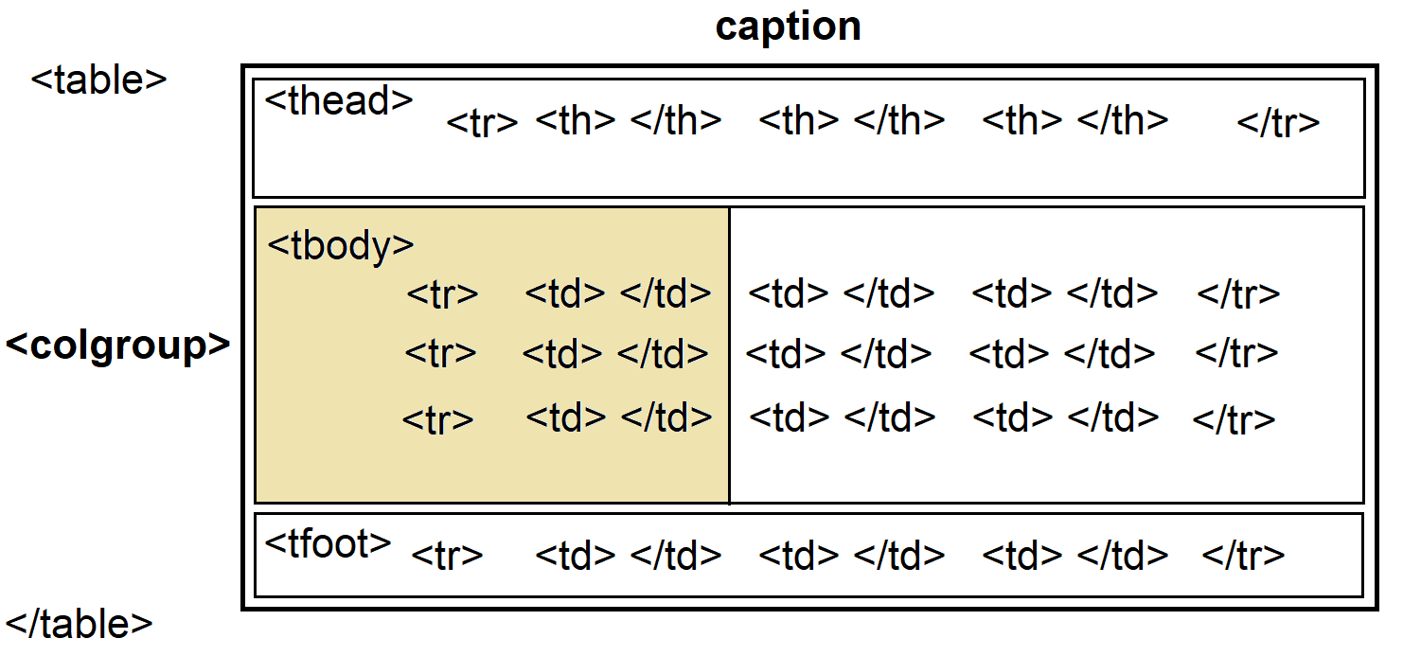

Slide 6
Tags
table
thead
tbody
tfoot
th
tr
td
colgroup
- caption
Attributes
frame
border
rules
width
height
align
valign
bgcolor
background
cellspacing
cellpadding
colspan
rowspan

